Slide 1





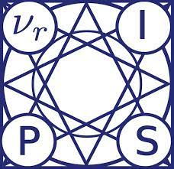
A Simple Solution for Offline Imitation from Observations and Examples with Possibly Incomplete Trajectories
Kai Yan, Alexander G. Schwing, Yu-Xiong Wang
University of Illinois Urbana-Champaign
Notes:
Tell you **about** our paper
Hi I’m Kai Yan, today I’ll tell you our paper “A Simple Solution for Offline Imitation from Observations and Examples with Possibly Incomplete Trajectories”.

Slide 2

Why offline imitation from observations?
Offline Imitation Learning (IL) is efficient
+ No reward labels
+ No online interactions
– Requires expensive expert demonstrations which are hard to get
Image Source: Internet
Department of Computer Science
GRAINGER COLLEGE OF ENGINEERING
Notes:
We will explain our work by answering the questions raised by the title. First of all, why do we need offline imitation from observations? As we know, opposed from online reinforcement learning (RL) from scratch, offline imitation learning (IL) removes both the need for reward labels, which is not always available, as well as online interactions, which could be costly and requires many to converge. However, offline IL has its own shortcomings, which is that it needs expensive expert demonstrations for every new task.
More specifically, in this paper we focus on expert data shortage where expert demonstrations are state-only. This could happen when you try to learn from video, where the expert action is unavailable, or training a robot from another embodiment, where expert action is meaningless. Thus, in such scenarios, we want to Learn from Few Expert states and larger unlabeled, mixed-quality state-action dataset.

Slide 3
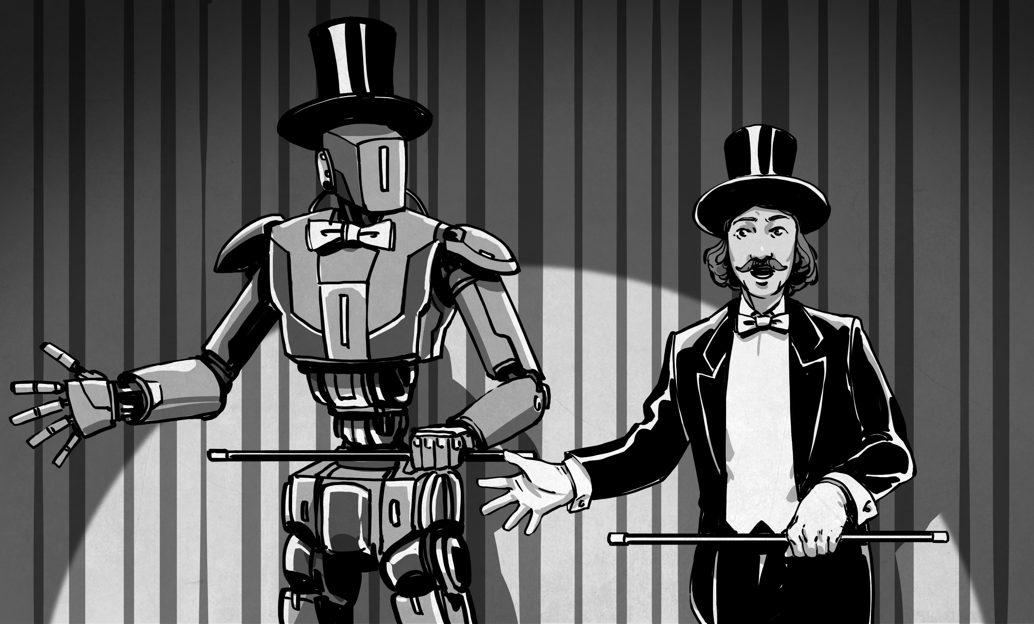
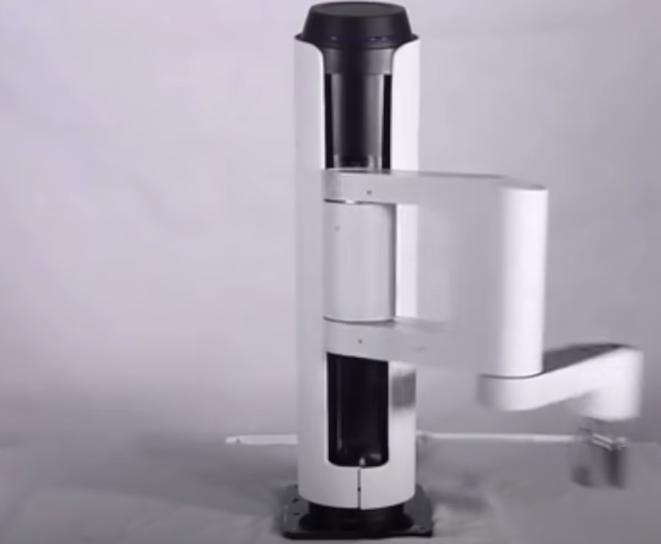

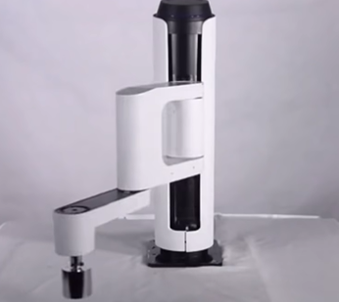
Why offline imitation from observations?
Offline Imitation Learning (IL) is efficient, but expert demonstrations are few and sometimes state-only
Learn from few expert states + large, mixed-quality state-action dataset
Learning from video
Embodiment difference
Image Source: Internet
Department of Computer Science
GRAINGER COLLEGE OF ENGINEERING
Notes:
We will explain our work by answering the questions raised by the title. First of all, why do we need offline imitation from observations? As we know, opposed from online reinforcement learning (RL) from scratch, offline imitation learning (IL) removes both the need for reward labels, which is not always available, as well as online interactions, which could be costly and requires many to converge. However, offline IL has its own shortcomings, which is that it needs expensive expert demonstrations for every new task.
More specifically, in this paper we focus on expert data shortage where expert demonstrations are state-only. This could happen when you try to learn from video, where the expert action is unavailable, or training a robot from another embodiment, where expert action is meaningless. Thus, in such scenarios, we want to Learn from Few Expert states and larger unlabeled, mixed-quality state-action dataset.

Slide 4
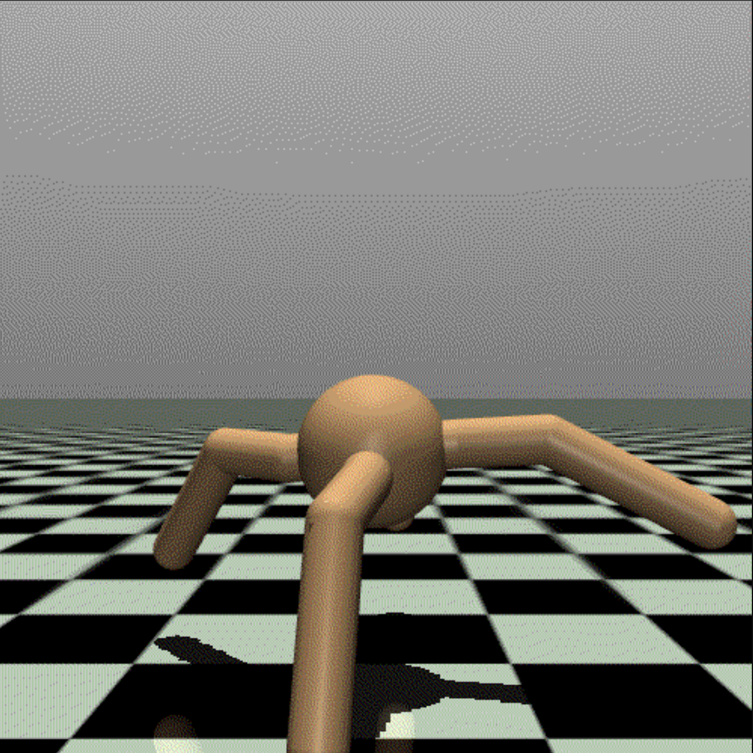
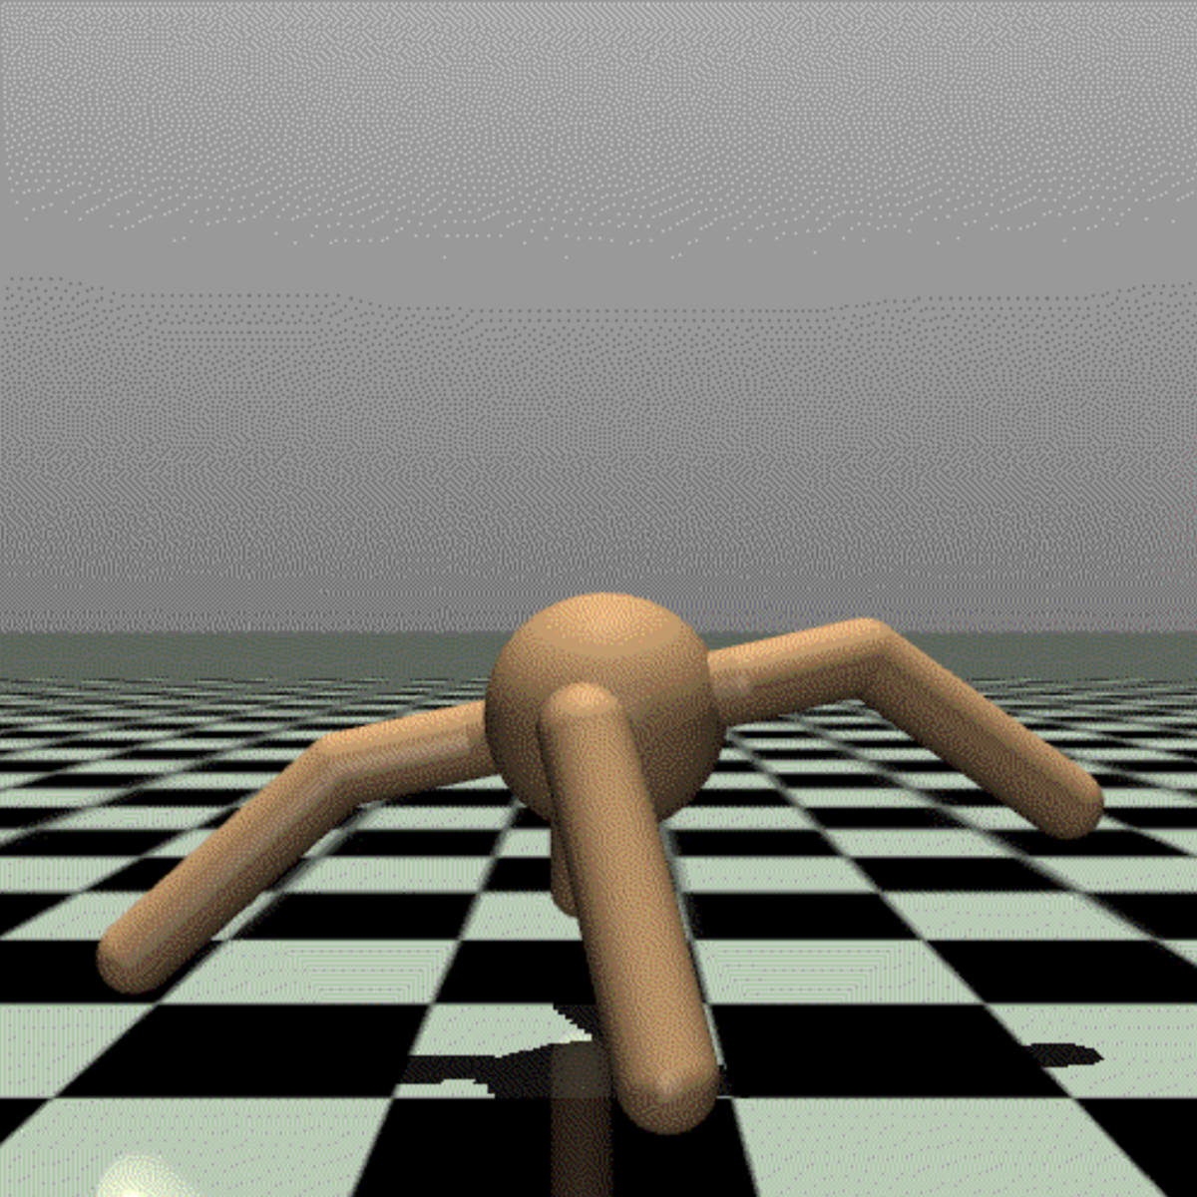
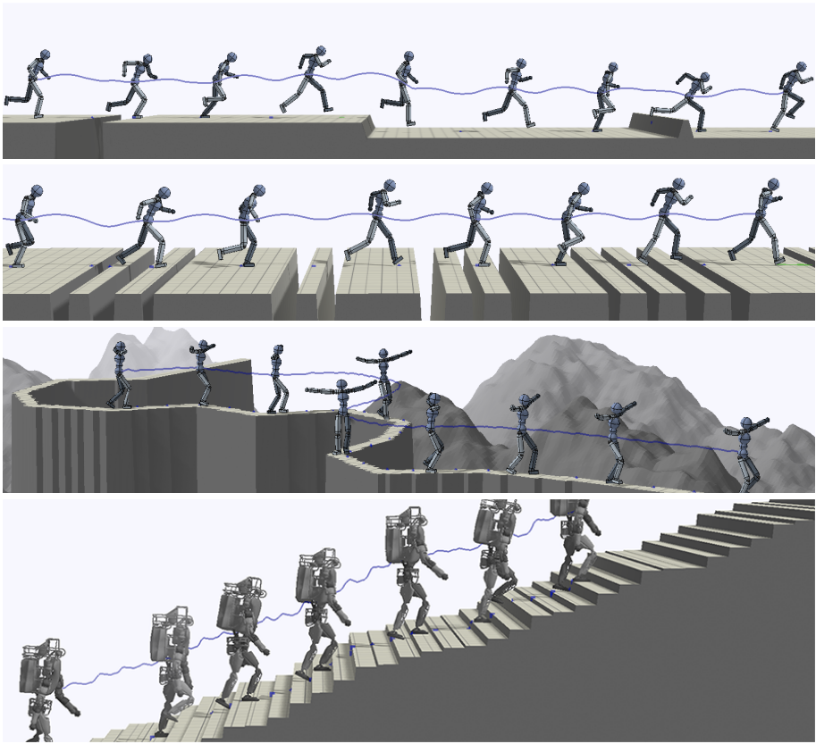
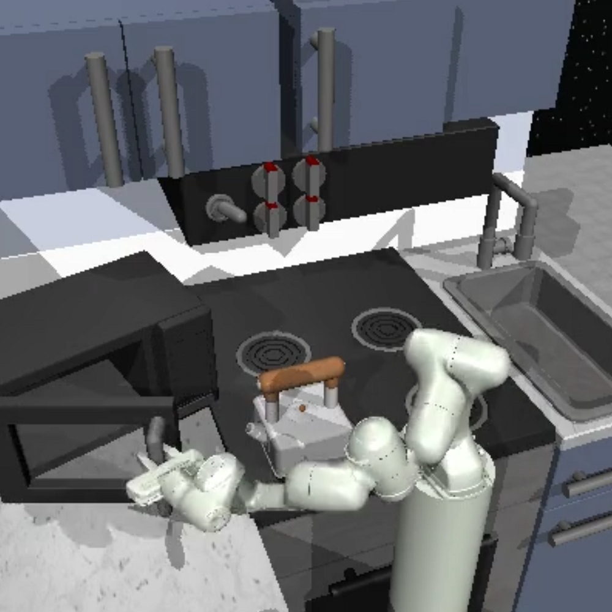
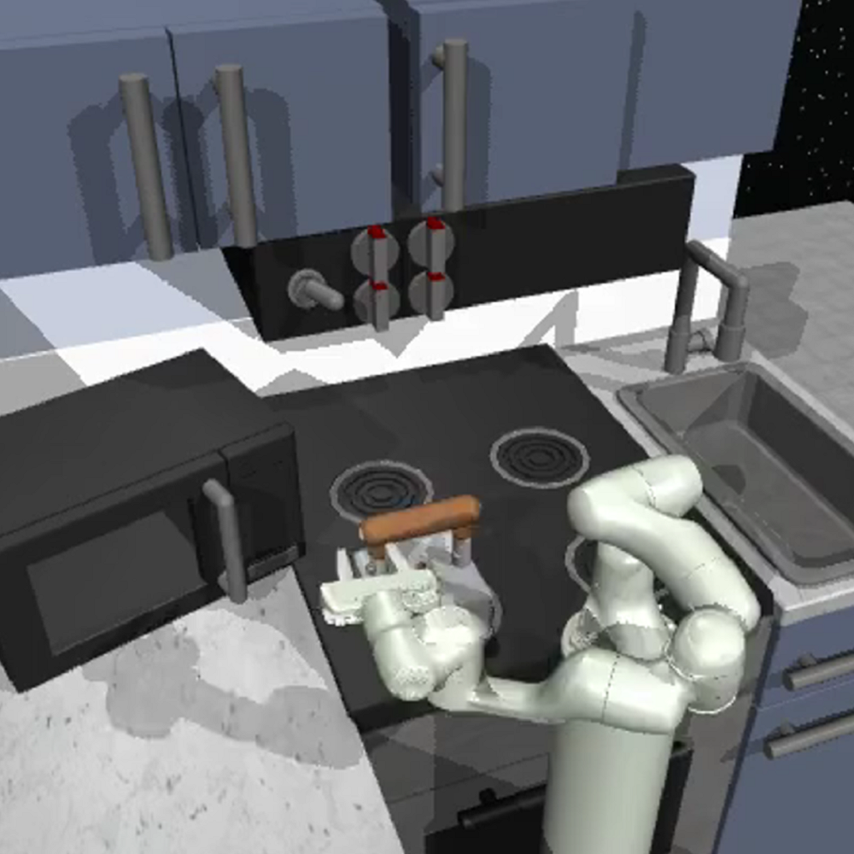
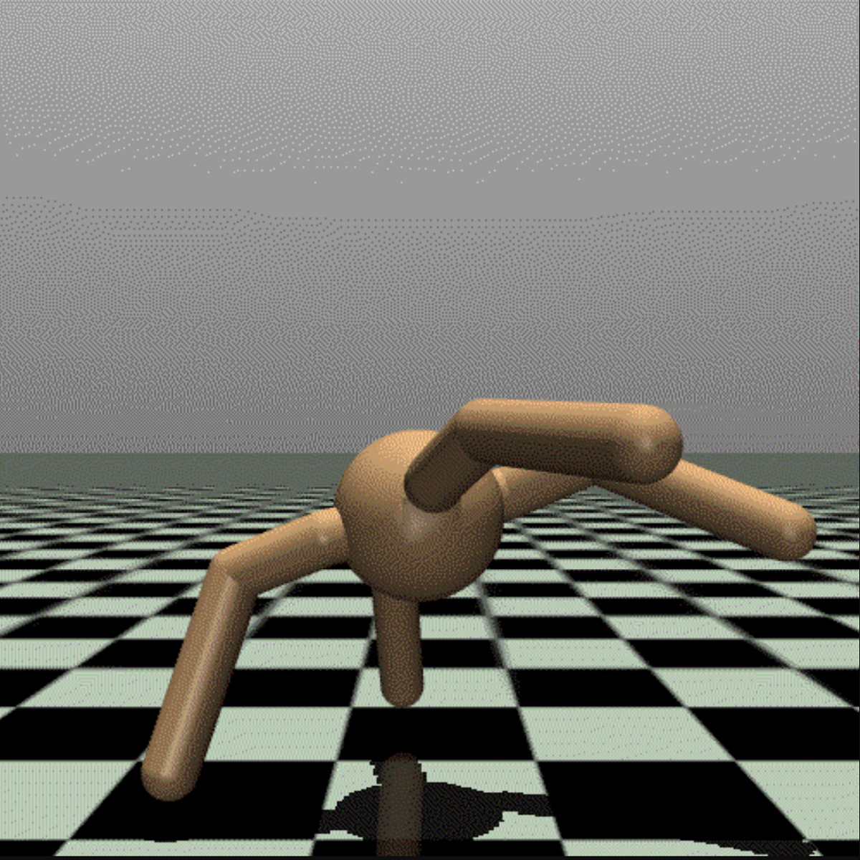

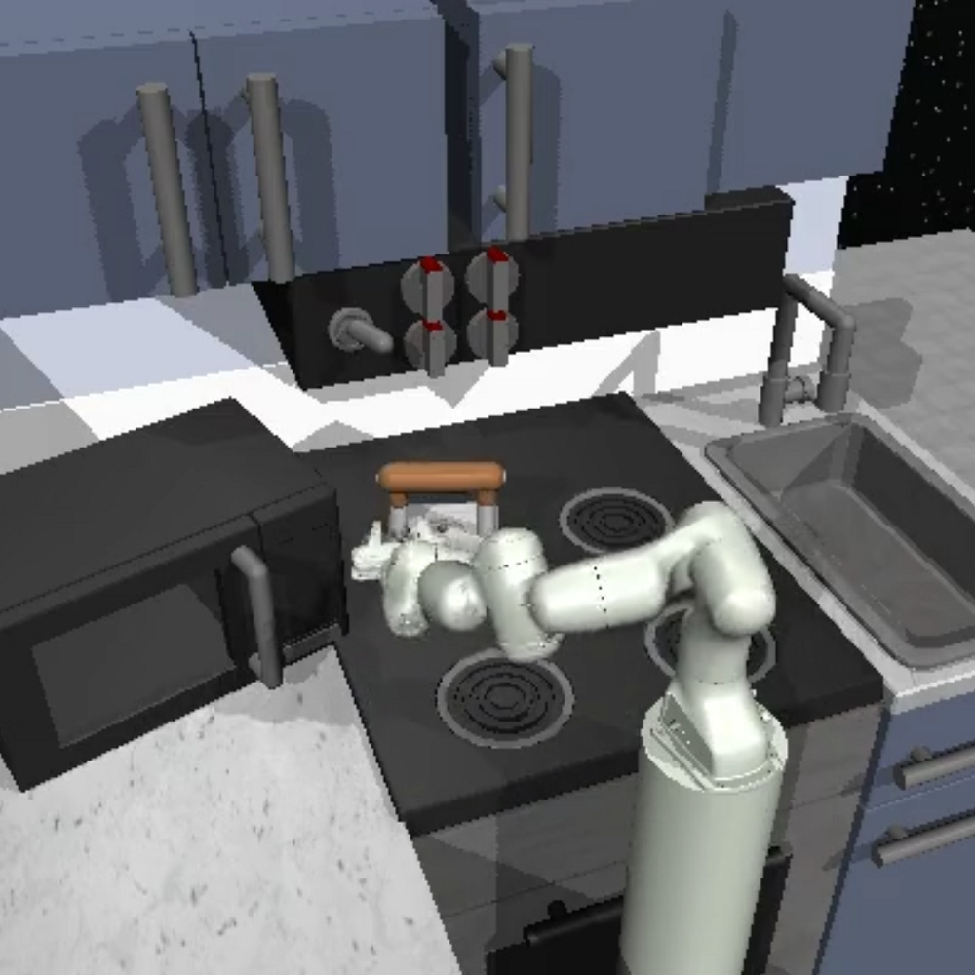


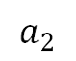
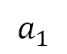

Why with possibly incomplete trajectories?
Some state(-action pairs) could be missing in either non-expert or expert data
Non-expert data could be corrupted
Expert demonstrations might only contain key frames or the desired goal (examples)
Current state-of-the-art methods are not robust in such settings: loss unbounded and practically overfitting if data is missing
$$s_{1}$$
$$a_{1}$$
$$s_{2}$$
$$a_{2}$$
Goal 1
$$s_{4}$$
?
?
Goal 2
Corrupted trajectory
Key frames [1]
Goal-only (Examples)
[1] X. Peng et al. DeepMimic: Example-Guided Deep Reinforcement Learning of Physics-Based Character Skills. In ACM Trans. Graph, 2018.
Department of Computer Science
GRAINGER COLLEGE OF ENGINEERING
Notes:
Then, The next question is, why we want to consider possibly incomplete trajectories when learning from observations? This is because some terms could be missing in either unlabeled or expert data. For example, Unlabeled data could be corrupted, and Expert demonstrations might only contain the key frames or even just the desired goal, the latter of which called “learning from examples”.
Current state-of-the-art methods, however, are not robust to such settings; they theoretically diverges with unlabeled data missing and practically overfitting with expert data missing, which we have a detailed analysis in our paper. To address such issue is a main motivation of our work.
.

Slide 5
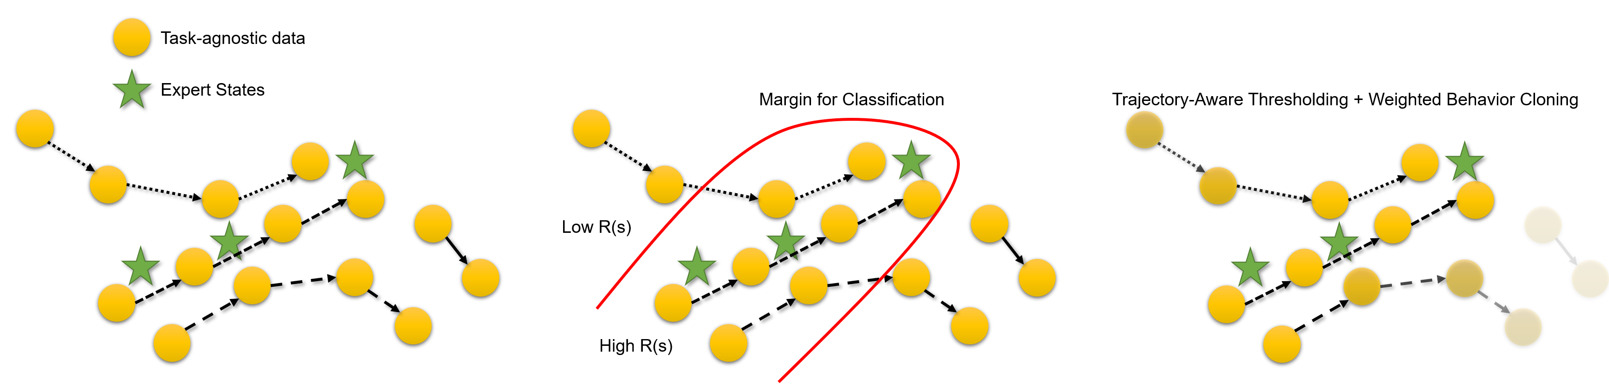
How simple is our solution?
Locate near-optimal segments in non-expert data + learning more from them
States from non-expert data (unlabeled samples)
States from expert data (positive samples)
High Transparency = Low Weight
Department of Computer Science
GRAINGER COLLEGE OF ENGINEERING
Notes:
Clarify that it is positive-unlabeled samples (add parentheses in the figure)
Non-expert states = states from non-expert trajectory
Now, with the importance of the problem we study, the next question is natural: what is our simple solution, and how simple it is? Our solution contains two parametric steps.
The first step is to train a discriminator with positive-unlabeled learning to label reward R(s) for each state. As illustrated in the figure, such discriminator takes expert states as positive samples, and states from task-agnostic data as unlabeled samples, and the score given by the positive-unlabeled discriminator gives scores that indicates whether a state is desirable or not. Such positive-unlabeled design considers possible near-optimal trajectory segments in the task-agnostic data, and thus gives better classification margins than discriminators that takes task-agnostic data as negative samples.
The second step is weighted behavior cloning on task-agnostic data, where the weights is proportional to discounted return with exponentiated reward, and the exponent is for thresholding between the high and low quality data. The best part for such weight is that it is non-parametric, and robust to missing steps in the middle.

Slide 6
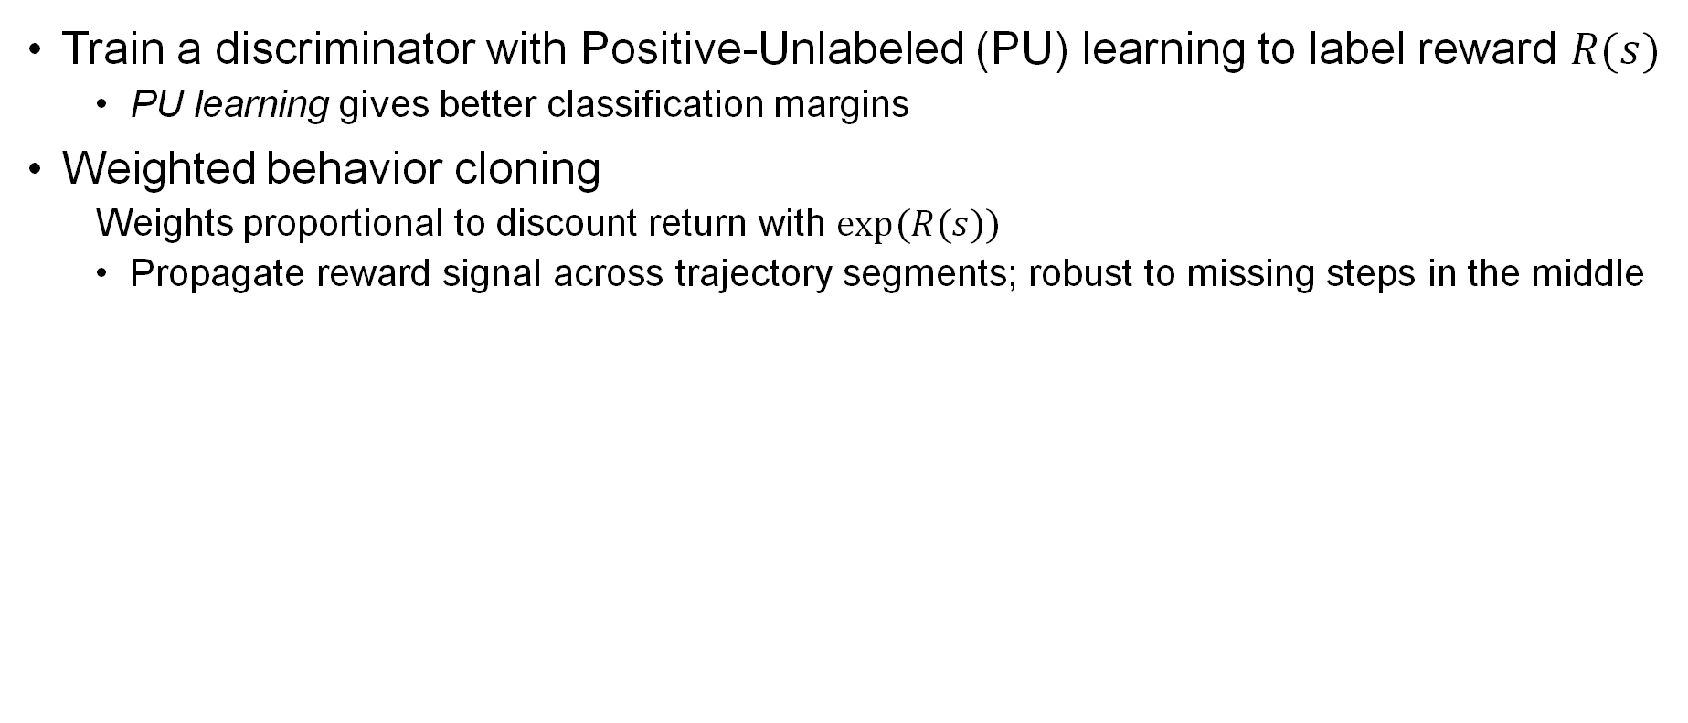
How simple is our solution?
Train a discriminator with Positive-Unlabeled (PU) learning to label reward $R(s)$
PU learning gives better classification margins
Weighted behavior cloning
Weights proportional to discount return with $exp⁡(R(s))$
Propagate reward signal across trajectory segments; robust to missing steps in the middle
States from non-expert data (unlabeled samples)
States from expert data (positive samples)
High Transparency = Low Weight
Department of Computer Science
GRAINGER COLLEGE OF ENGINEERING
Notes:
Clarify that it is positive-unlabeled samples (add parentheses in the figure)
Non-expert states = states from non-expert trajectory
Now, with the importance of the problem we study, the next question is natural: what is our simple solution, and how simple it is? Our solution contains two parametric steps.
The first step is to train a discriminator with positive-unlabeled learning to label reward R(s) for each state. As illustrated in the figure, such discriminator takes expert states as positive samples, and states from task-agnostic data as unlabeled samples, and the score given by the positive-unlabeled discriminator gives scores that indicates whether a state is desirable or not. Such positive-unlabeled design considers possible near-optimal trajectory segments in the task-agnostic data, and thus gives better classification margins than discriminators that takes task-agnostic data as negative samples.
The second step is weighted behavior cloning on task-agnostic data, where the weights is proportional to discounted return with exponentiated reward, and the exponent is for thresholding between the high and low quality data. The best part for such weight is that it is non-parametric, and robust to missing steps in the middle.

Slide 7
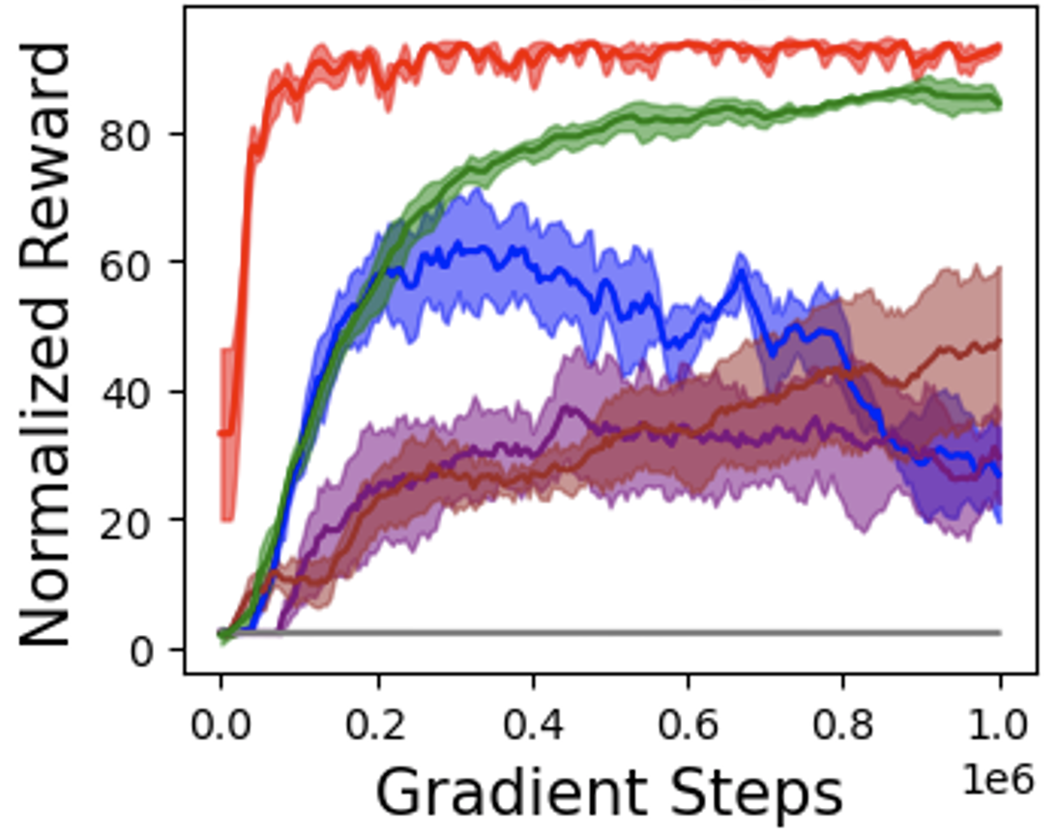
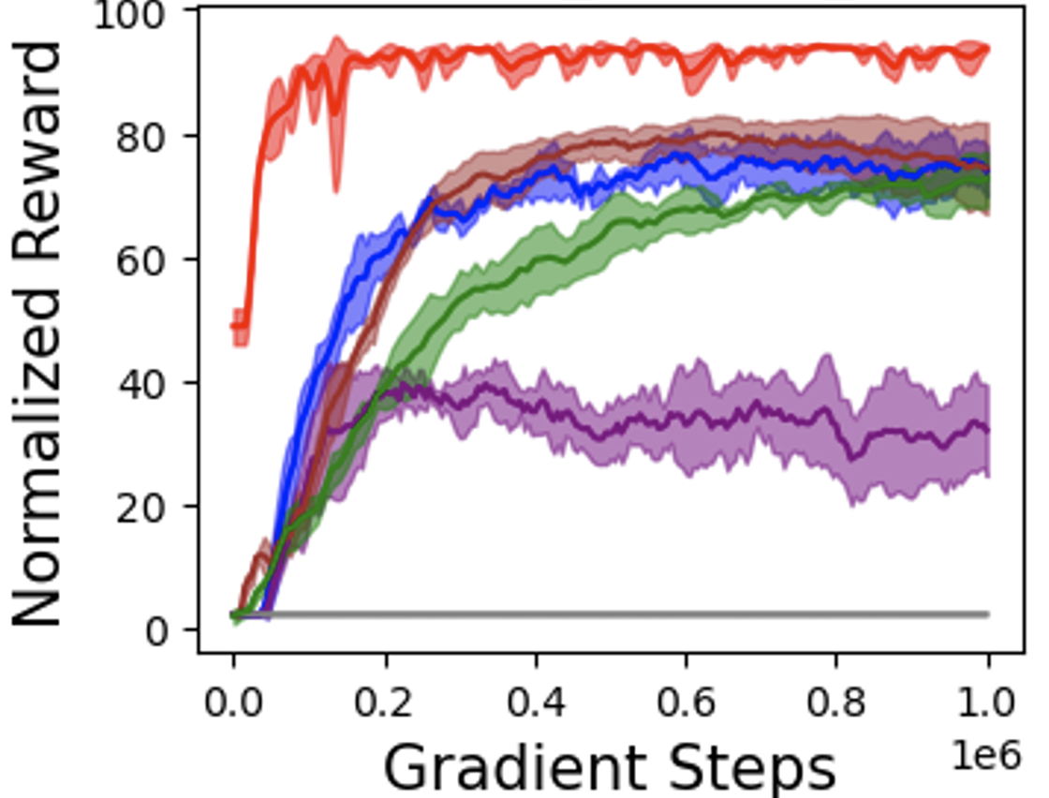
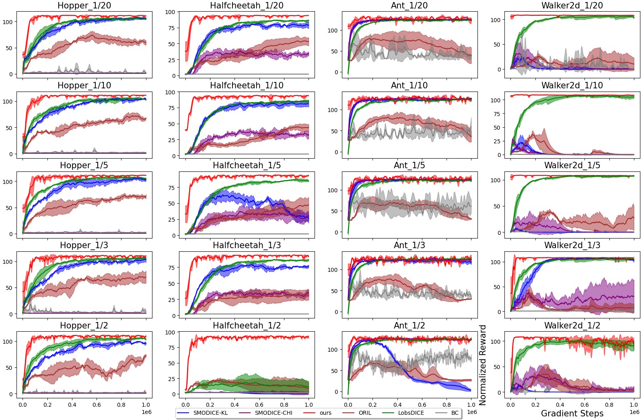
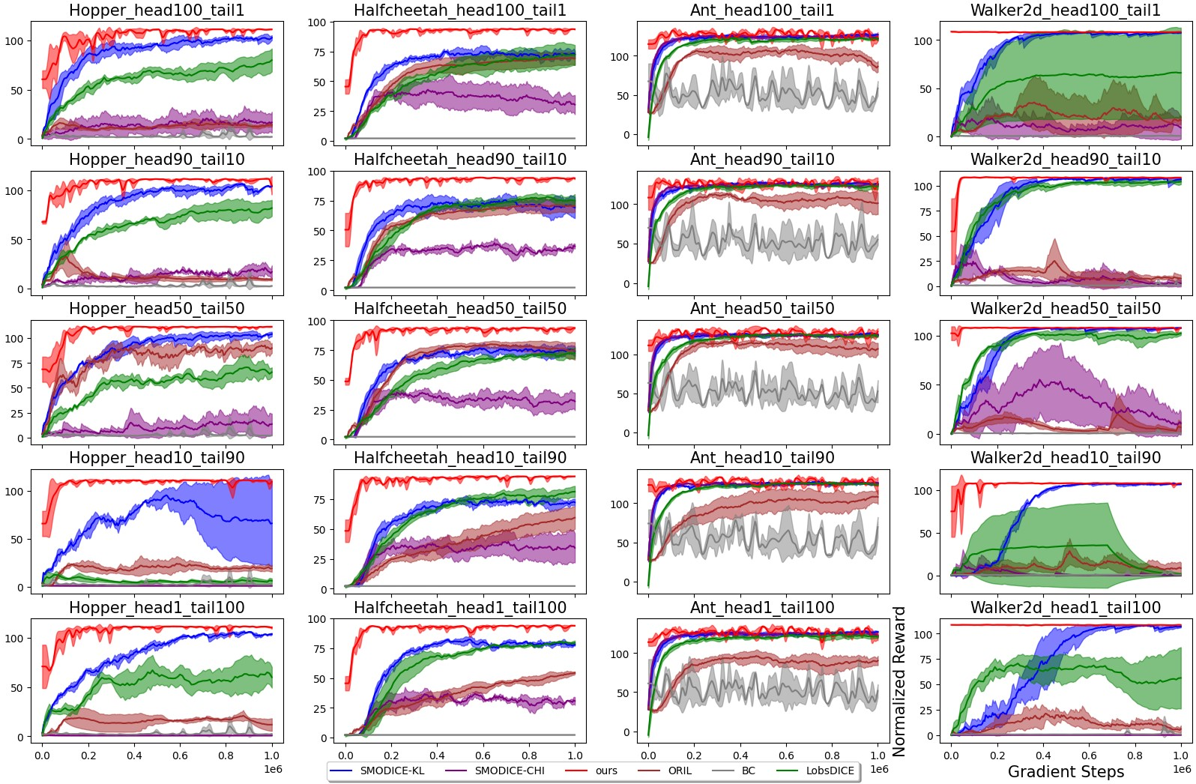
How well does our simple solution work?
Outperforms many baselines on a variety of settings
Normalized reward curve (higher is better); ours highlighted in red
Incomplete non-expert dataset
Incomplete expert dataset
[1] Y. J. Ma et al. Smodice: Versatile offline imitation learning via state occupancy matching. In ICML, 2022.
[2] G. Hyeong Kim et al. Lobsdice: Offline learning from observation via stationary distribution correction estimation. In NeurIPS, 2022.
[3] K. Zolna et al. Offline learning from demonstrations and unlabeled experience. In Offline Reinforcement Learning Workshop at NeurIPS, 2020.
Department of Computer Science
GRAINGER COLLEGE OF ENGINEERING
Notes:
Show one -> show all; too many figures at start. One curve at the beginning; “generally” click
Show one on left-hand side; one on right-hand side; do animations “have many more”
Apparently, after knowing the solution, the final question is: how does such a simple solution works? We have conducted extensive experiments and proved that our method outperforms many baselines in a variety of settings. On this slide, we show the performance over two major settings in our paper, which are learning with incomplete unlabeled and expert dataset. The performance is shown in normalized reward curves, and the higher is better. It is clearly shown that our method with the red line always come out at top, which means that it is the best method.

Slide 8
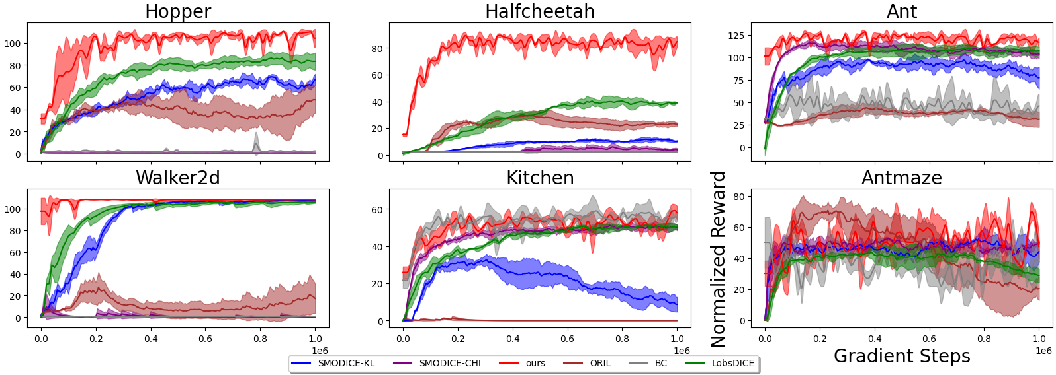
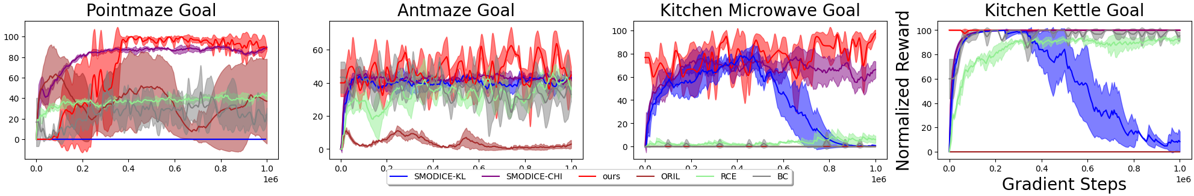
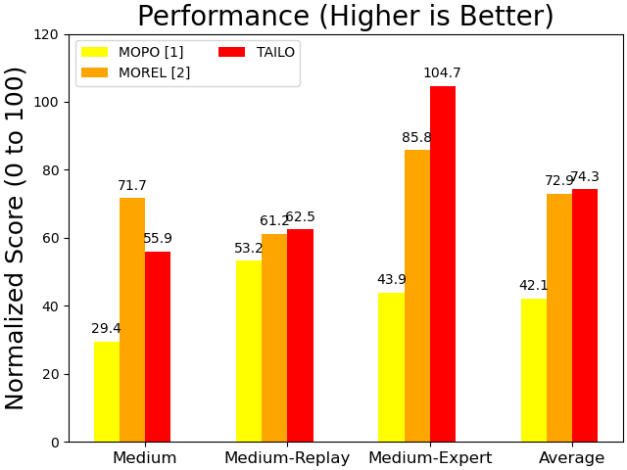
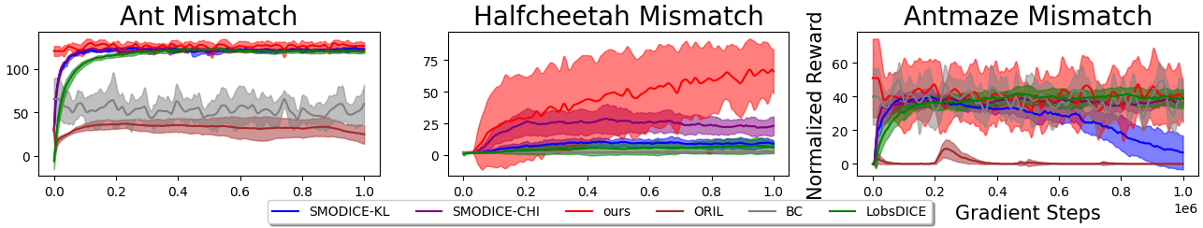
How well does our simple solution work?
Our method also yields compelling results on:
Robust to hyperparameters
Low average quality non-expert data
Offline IL from examples
Standard D4RL offline RL benchmarks
(vs. model-based RL, ours without using reward label)
Expert with different embodiments
[1] T. Yu et al. Mopo: Model-based offline policy optimization. In NeurIPS, 2020.
[2] R. Kidambi et al. Morel: Model-based offline reinforcement learning. In NeurIPS, 2020.
[3] B. Eysenbach et al. Replacing rewards with examples: Example-based policy search via recursive classification. In NeurIPS, 2021.
Department of Computer Science
GRAINGER COLLEGE OF ENGINEERING
Notes:
Have plots appear one at a time; put animation on the slide
Besides, we find that our method is also impressive for many scenarios, such as Average low-quality unlabeled dataset, Expert with different embodiments, Offline IL from Example, and even better than model-based RL methods without ever using reward label. We also conduct thorough ablations, which suggests that our method is robust with hyperparameters.

Slide 9
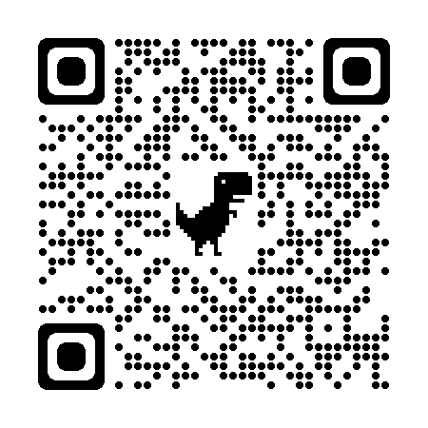
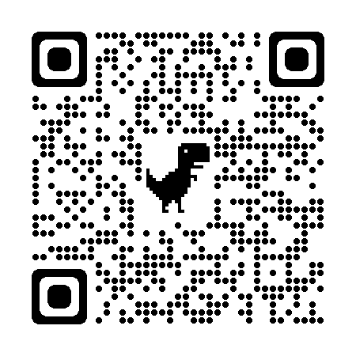
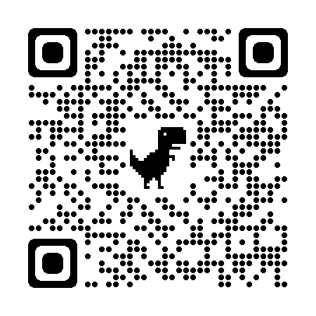
Thank you!
Feel free to contact kaiyan3@illinois.edu for any question!
Code repository
Website
PDF of our paper
https:github.com/
KaiYan289/TAILO
https://rb.gy/pn3i1a
arXiv: 2311.01329
Department of Computer Science
GRAINGER COLLEGE OF ENGINEERING
Notes:
Also put url for the website; use url shortener;make it more memorizable
That’s all for my presentation; please scan the QR code for more information about our paper. Thanks for listening!

